Slide 1
DONaid
Capstone Project Presentation
GITHUB LINK
2025-10-07-se-pt-au Justina Bosco | 2 April 2026

Slide 2
What is DONaid
Notes:
DONaid is a lightweight web app

Slide 3
Overview
DONaid is a lightweight donation marketplace web application.

Slide 4
Core features
User registration + login
Create donation listings (title, description, category, condition, image)
Browse and search available donation items
Real‑time messaging using Socket.IO

Slide 5
Stakeholders
Donors: post items and coordinate handover
Recipients: browse items and request via message
Community groups/charities: source items

Slide 6
Business problem
Many households have usable items they no longer need, while others cannot easily afford replacements. A simple platform for local donation reduces waste and helps communities.

Slide 7
How is DONaid different from other platforms?

Slide 8
VALUE
Lower landfill waste and carbon impact
Improves access to essential household goods
Strengthens community support networks

Slide 9
Non-functional requirements
Usable and responsive UI (Material UI)
Secure authentication and authorization
Maintainable MVC backend architecture
Automated testing to support reliability

Slide 10
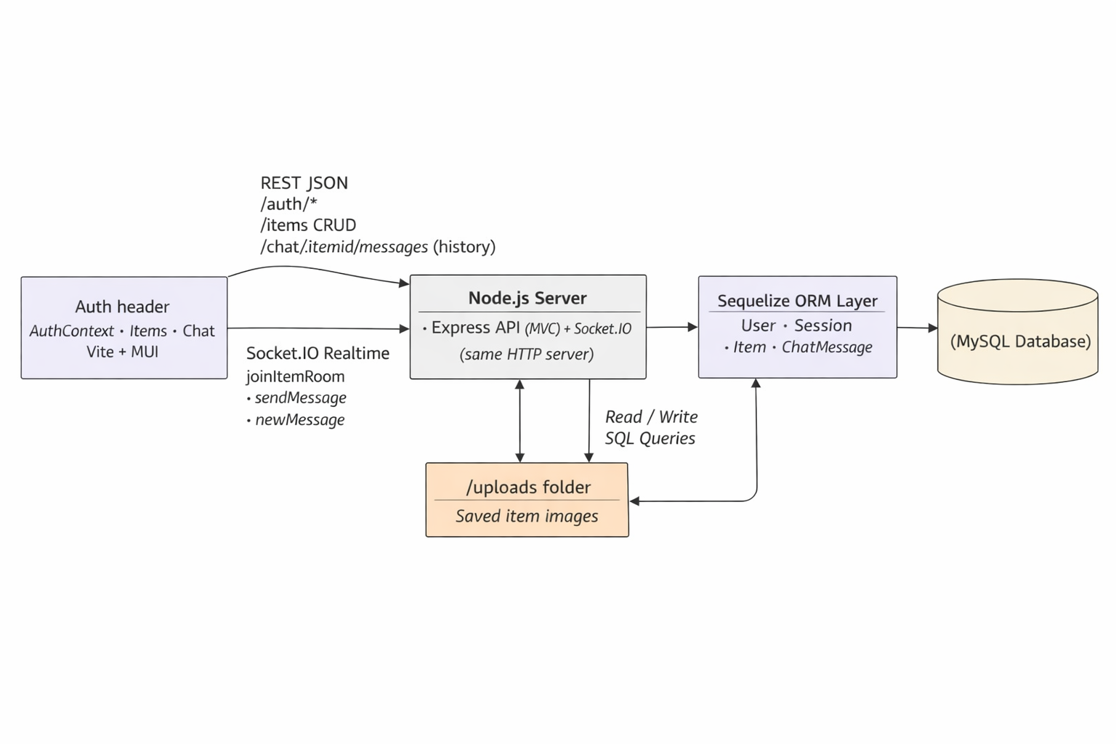
Architecture
Notes:
Express and Socket.IO run on the same Node.js server to simplify deployment and authentication

Slide 11
User Stories
As a Donor | As a Recipient
As a donor, I want to log in securely so that only I can modify my items. | As a recipient, I want to browse available items so I can find what I need.
As a donor, I want to list items with images and descriptions so that recipients can clearly understand what I’m offering. | As a recipient, I want to search and filter items so I can narrow down results based on category or name.
As a donor, I want to edit or delete my own listings so I can keep my available items up to date. | As a recipient, I want to message donors directly about specific items so I can ask questions or arrange collection.
As a donor, I want to receive messages from interested recipients so I can coordinate item pickup or delivery. | As a recipient, I want to view item details and images so I can decide whether the item meets my needs.

Slide 12

Dependencies
npm express
dotenev
sequelize
mysql2
test
supertest

Slide 13
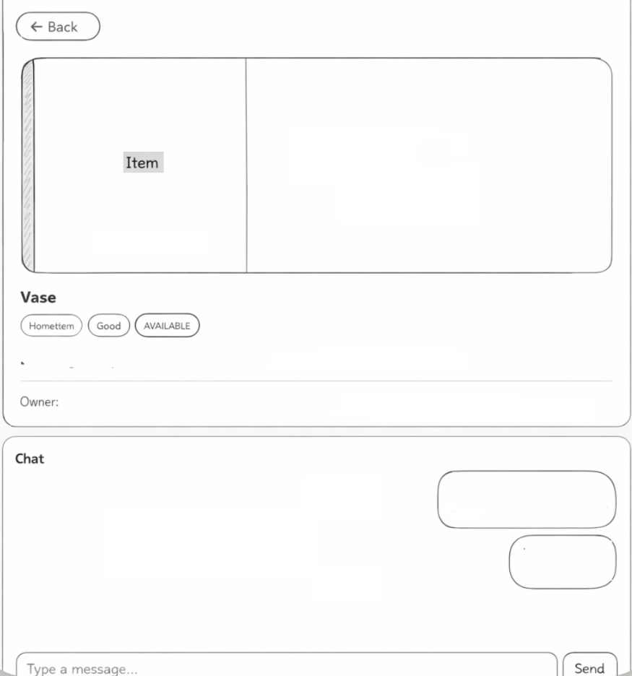
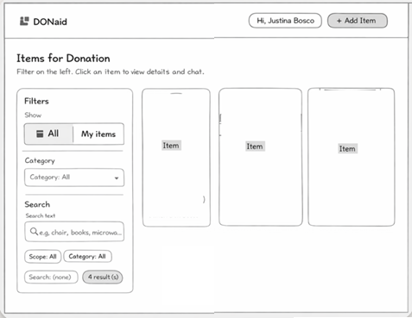
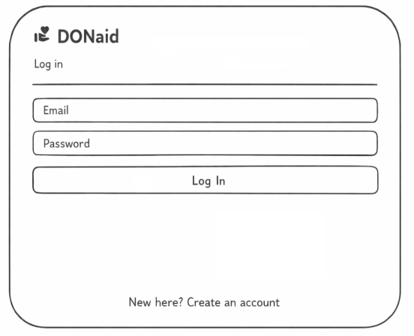
Wireframe

Slide 14
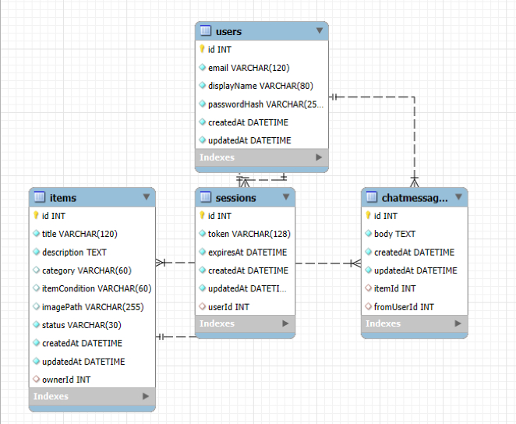
Schema

Slide 15
Testing
Using Thunder Client

Slide 16
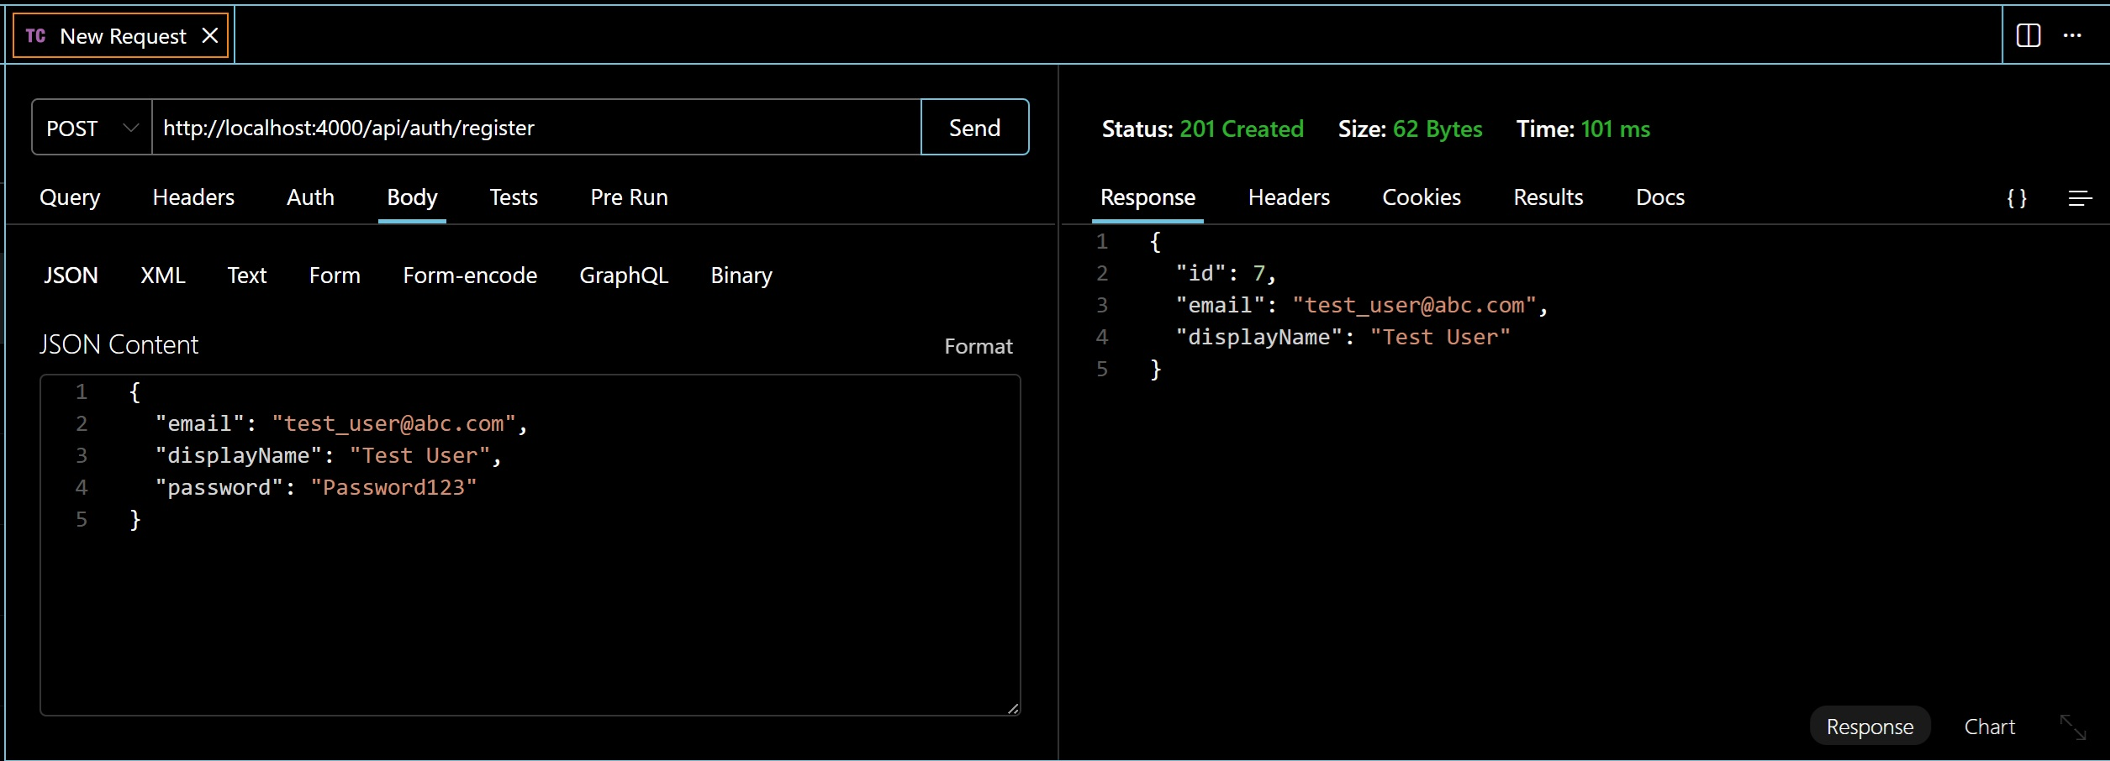

Registering a new user
Unlocking new horizons

Slide 17
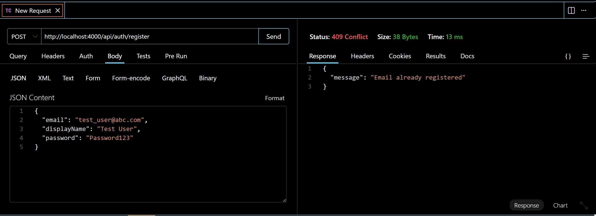
Registering an existing user
Unlocking new horizons

Slide 18
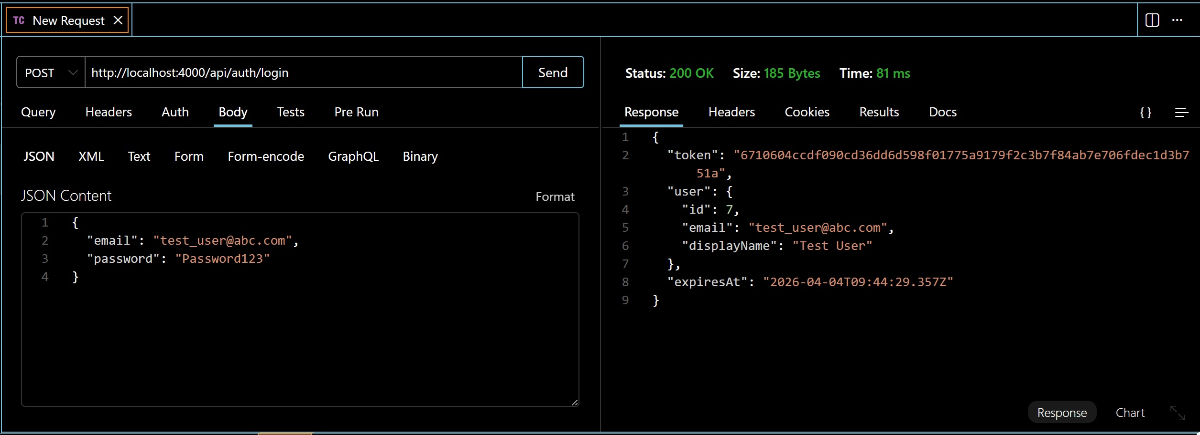
Logging in using correct credentials
Unlocking new horizons

Slide 19
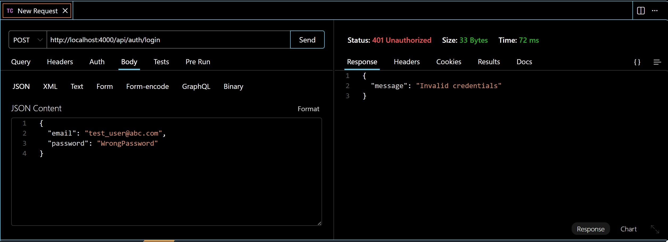
Logging in using invalid credentials
Unlocking new horizons

Slide 20
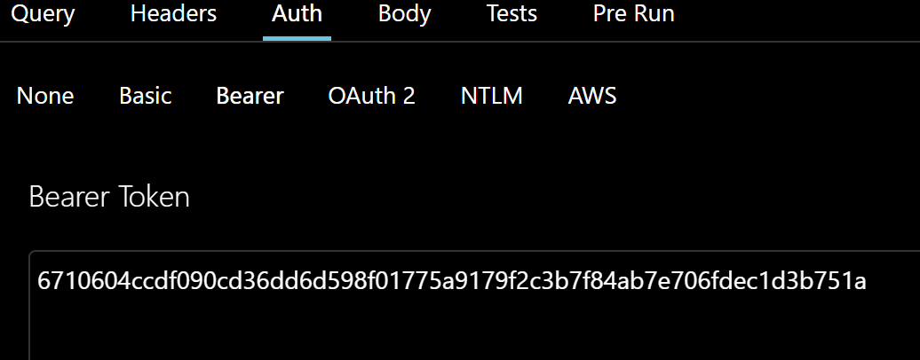
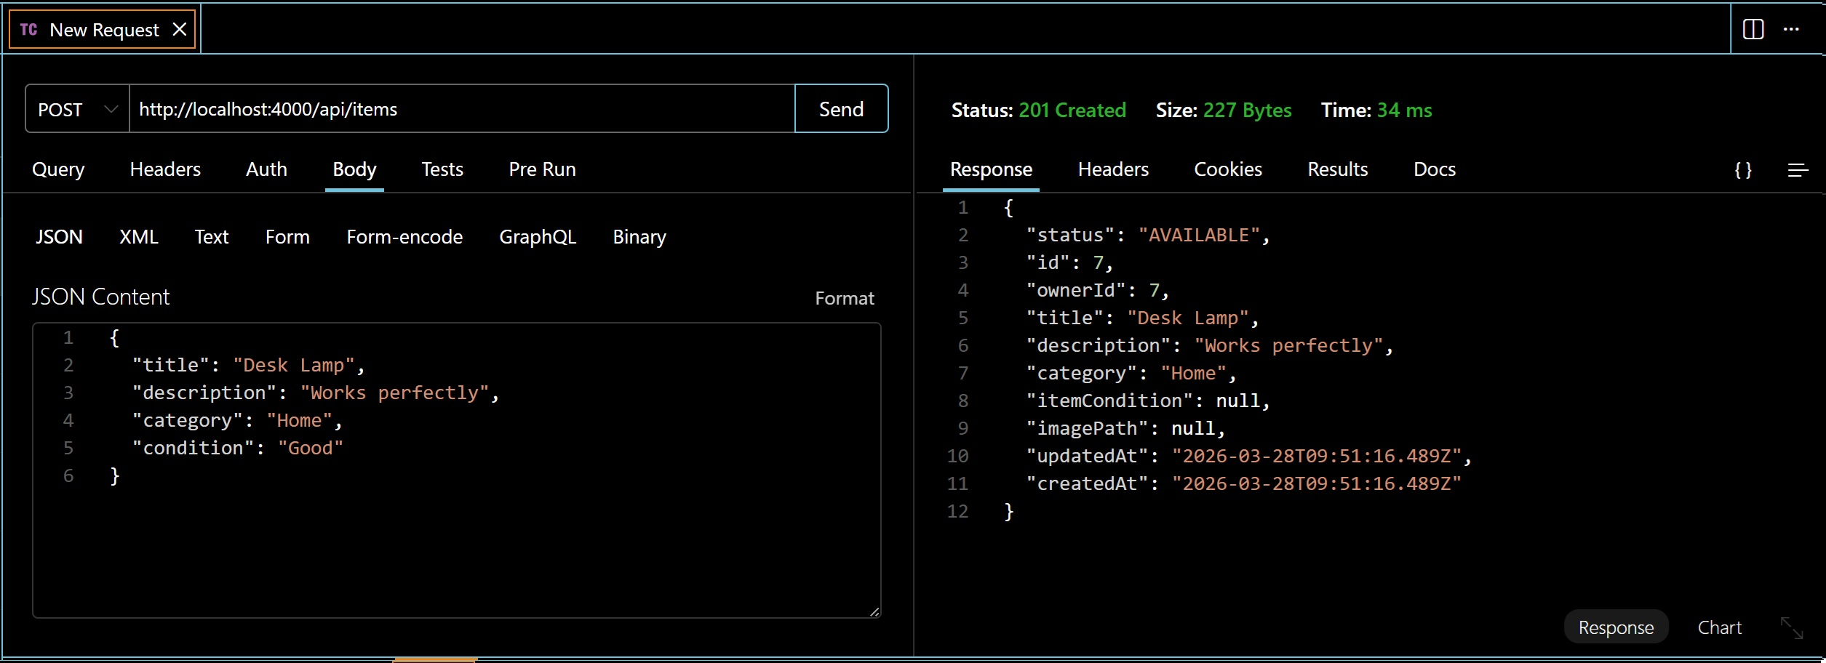
Posting item using valid token
Unlocking new horizons
Notes:
These tests validate authentication, authorization, and error handling

Slide 21
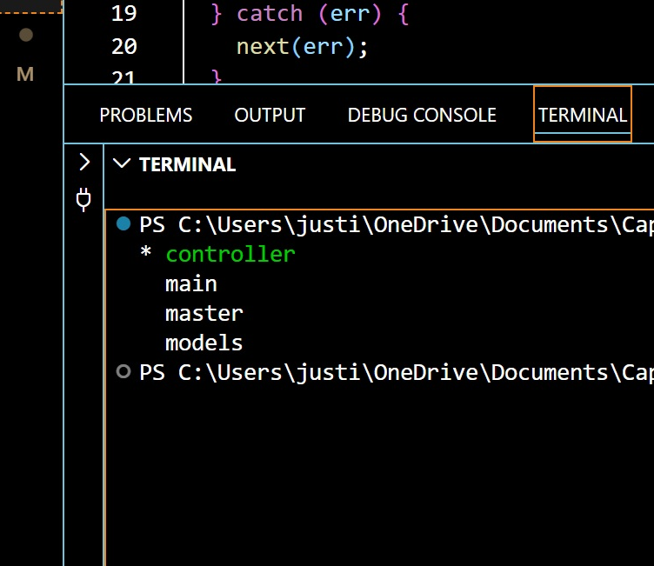
GIT Branches
Notes:
Branching allowed me to develop features safely and keep the main branch stable

Slide 22
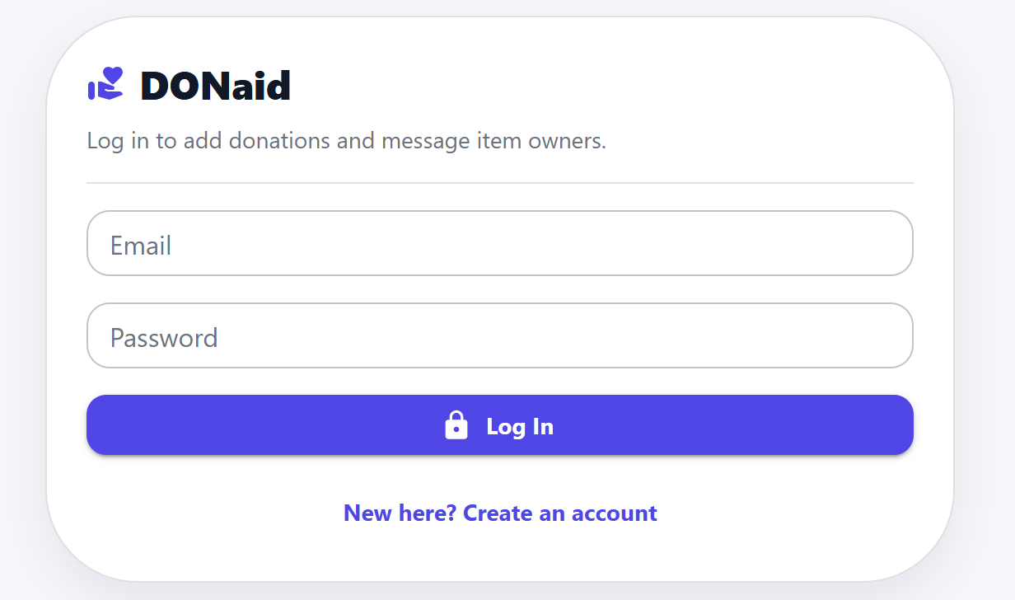
Log in Page
For existing users to log in using correct credentials

Slide 23
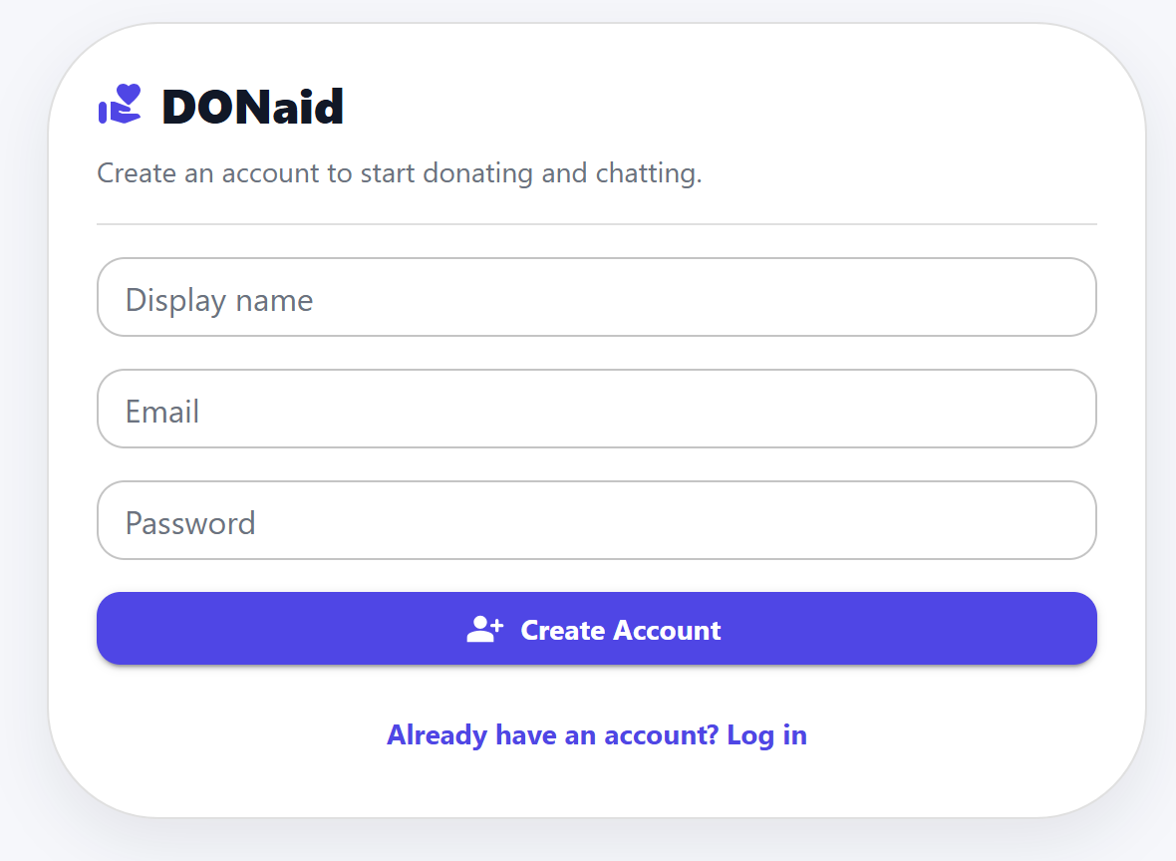
Sign up Page
For new users to create an account

Slide 24
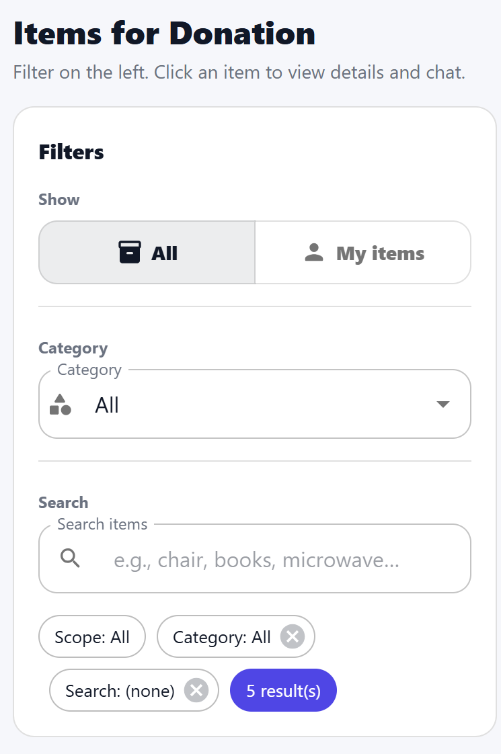
Filtering Pane
For users to search for all listed items
For users to manage their posted items
To filter items according to requirement

Slide 25
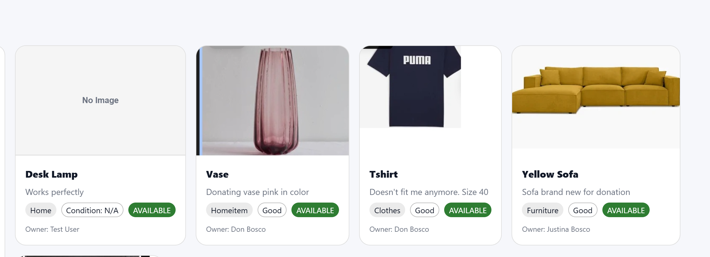
Listed Items
The right side of the page displays all the items listed by all the users by default

Slide 26
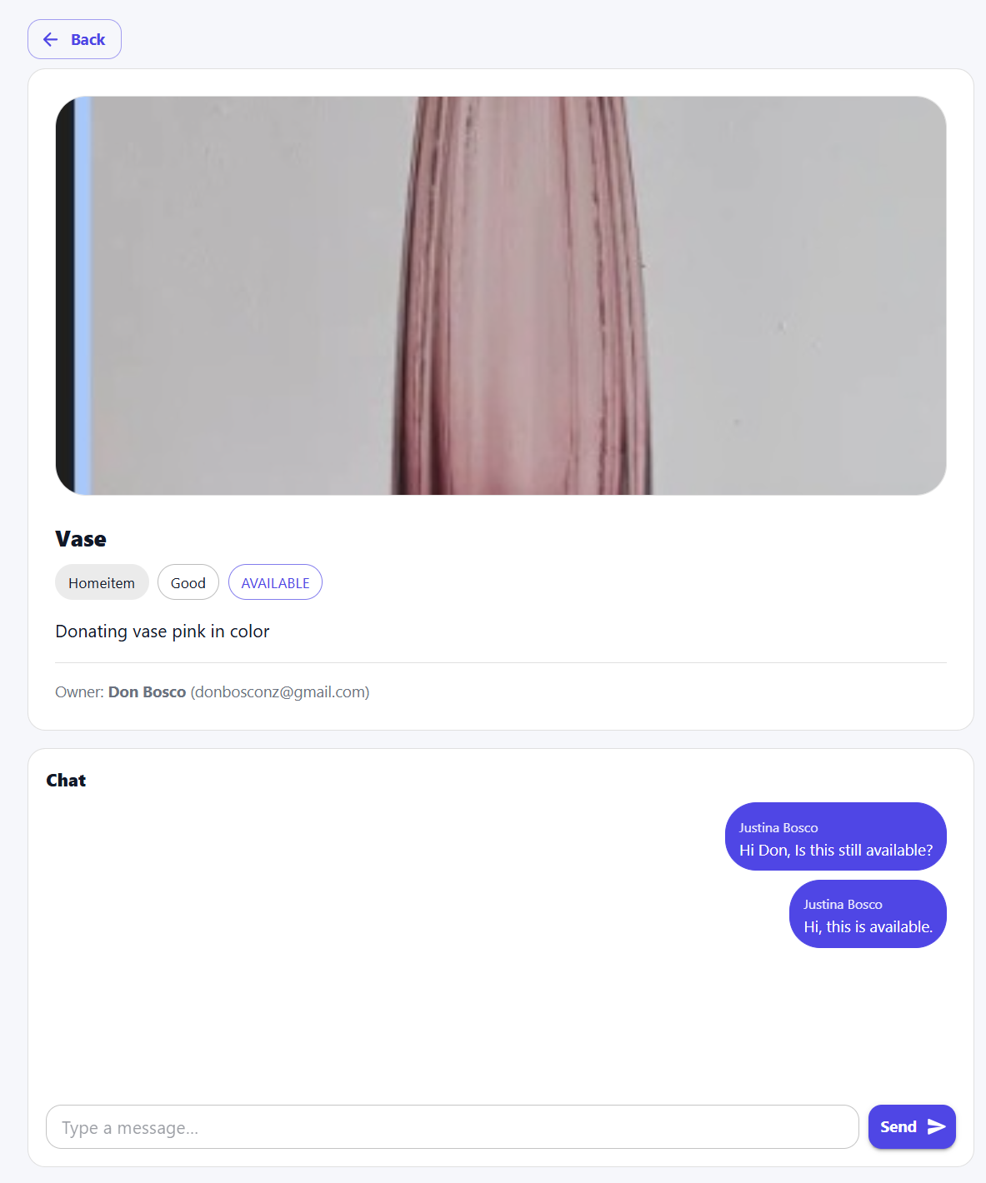
Individual Items Page
Individual item with description to enable real-time chatting, connecting donor and recipient

Slide 27
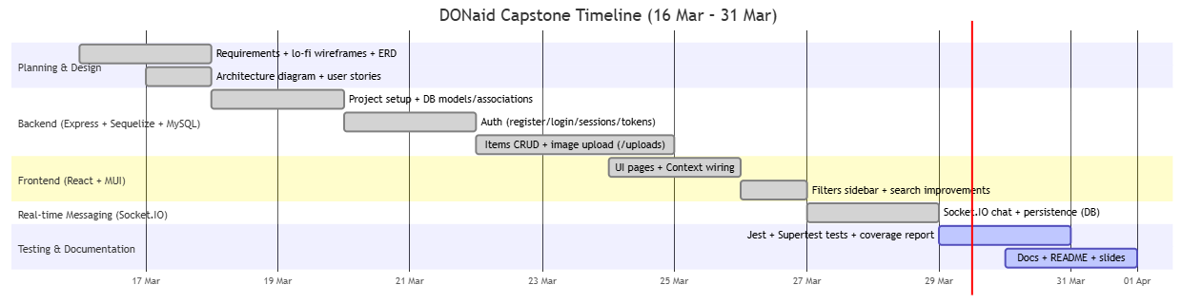
Project timeline

Slide 28
Future Improvements
Email Notification | Future enhancement will enable email notifications to donors when any user is interested in their item
Location | Geographic Information System (GIS) functionality can help users locate the donor
Password Reset | Very essential, users will be able to reset their password

Slide 29
Special thanks to our trainer for his guidance throughout the project

Slide 30
Thank You
Justina Bosco
justinabosconz@gmail.com
https://www.linkedin.com/in/justina-bosco-514b86188/

